Slide 1


Improving the Lives and Learning of Children and Youth
Updated: 08/20/2018

Slide 2

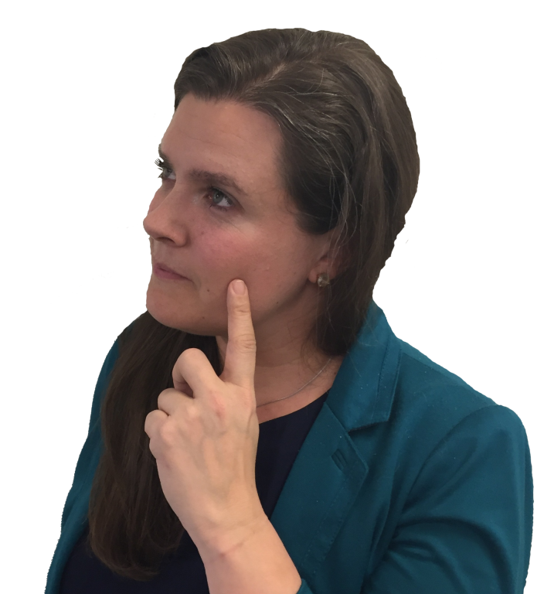
What do you want for your career?
Help create effective schools?
Assist families and teachers?
Make a positive difference in someone’s life?
Contribute to supportive communities?
Work with children and/or youth?

Slide 3

What are you looking for in a job?
Lots of
job openings?
Diverse roles and responsibilities?
Good salary
and benefits?
Job flexibility
and stability?

Slide 4
School Psychology might be the career for you!

Slide 5
Who are school psychologists?
Highly-qualified professionals with a graduate degree
Work in schools and related settings
Provide comprehensive psychological and educational services to diverse students
Promote children’s learning, positive behavior, and development
Support students’ social, emotional, and mental health
In Texas, school psychologists are also referred to as Licensed Specialists in School Psychology

Slide 6
What do School Psychologists do?
Conduct assessments, counseling, and other mental health and academic services
Work with children individually and in groups
Collaborate with parents, teachers, and administrators
Help schools, families, and communities provide successful outcomes for children

Slide 7
When do children NEED a School Psychologist?
Learning difficulties
Behavior and attention concerns
Problems with peers (isolation, bullying)
Depression and other mental health issues
Coping with crisis & trauma (natural disasters, war, school violence, abuse, rape)
Poverty, violence, homelessness, foster youth, loss, grief
Family issues (divorce, death, substance abuse, military deployment)

Slide 8

Most school psychologists work in K-12 public schools.

Slide 9



Where do School Psychologists work?
86%
Public Schools
7.7%
10%
Colleges & Universities
8%
Private Schools
7%
Private Practice
6.7%
Faith-Based Schools
1.6%
Dept. of Education
1.5 Clinics & hospitals
Sources: Walcott, Charvat, McNamara, & Hyson (2015)

Slide 10


Who are today’s School Psychologists?
Gender
83%
women
16%
men
Sources: Walcott, Charvat, McNamara, & Hyson (2015)

Slide 11
U.S. Demographics: Ratio of Girls to Boys Receiving Special Education Services
Girls
Boys
:

Slide 12
Who are today’s School Psychologists?
Racial/Ethnic Characteristics
Sources: Walcott, Charvat, McNamara, & Hyson (2015)

Slide 13
U.S. Demographics
Racial/Ethnic Characteristics
Source: www.census.gov

Slide 14
Who Are Today’s School Psychologists?
Linguistic Diversity
Sources: Walcott, Charvat, McNamara, & Hyson (2015)

Slide 15
U.S. Demographics
Linguistic Diversity – Ages 5 and older
Among those speaking a language other than English

Slide 16

Calling ALL potential school psychologists, but especially…
Males
Individuals from non-white backgrounds
Bilingual individuals

Slide 17
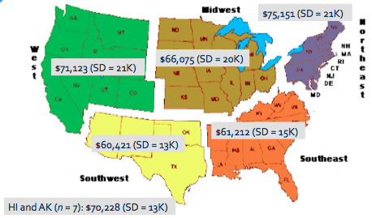
Average Salary by Region

Slide 18
How to Become a School Psychologist
Preparation for graduate school
Graduate school coursework
Practicum experience
Internship

Slide 19
Preparation for Graduate School
A bachelor’s degree with a major in:
  Psychology
  Child Development
  Sociology
  Education
  Other majors with pre-requisite foundational coursework
Volunteer or work experience with children and youth
  For example: camp, school, YMCA, or mentoring program

Slide 20
Considerations When Applying to Programs
Preparation for Graduate School
Degree level
Program Approval
Faculty
Size of program
Location
Research opportunities
Availability of financial support
Employment rates
Rate of completion
Advising opportunities
For more information: http://apps.nasponline.org/standards-and-certification/graduate-education/index.aspx

Slide 21
Selecting a Degree Program
Preparation for Graduate School
Specialist-Level (MA, EdS, SSP, CAGS, CAS)
>60 graduate semester hours
3+ years full-time (includes one year internship)
Entry-level degree
Typically allows for work in schools
Doctoral-level (PhD, PsyD)
>90 graduate semester hours
5-6+ years (includes one year internship)
Allows for work in schools, academia, research
More options for independent practice

Slide 22
Program Approval/
Accreditation
Preparation for Graduate School
Most graduate programs hold one or more types of accreditation:
  NASP-approval of specialist and doctoral levels
    http://www.nasponline.org/standards-and-certification/graduate-program-approval/nasp-approved-programs
  APA accreditation for doctoral programs
  State department of education approval for programs that lead to a state certificate or license for graduates

Slide 23
Graduate school coursework
Develops knowledge and skills in
Prevention and Intervention Services for Students and Families:
Assessment
Academic/learning interventions
Mental and behavioral health interventions
Instructional support
Special education services
Crisis preparedness, response, and recovery
Family-school-community collaboration
Cultural competence

Slide 24
Graduate school coursework
Develops knowledge and skills in
Foundations of Services Needed in Schools
Data collection and analysis
Resilience and risk factors
Consultation and collaboration
Diversity in development and learning
Research and program evaluation
Professional ethics
Education law

Slide 25
Graduate School Field Experiences
  Supervised experiences in schools, clinics, or related settings throughout your graduate program allow you to apply specific skills and techniques learned in courses.
  Culminating experience
  Provides intensive and supervised preparation for first job
  Full year (1200-1500+ hours)
Practicum Experiences
Internship

Slide 26
School Psychology Graduate Programs in Texas
University | Degree(s) Offered | NASP Approved
Abilene Christian | SSP | Yes
Baylor | EdS/PsyD | Yes/No
Houston Baptist | MA | No
Our Lady of the Lake | MA | No
Sam Houston State | SSP | Yes
Stephen F. Austin | SSP/PhD | Yes
Texas A&M- College Station | Ph.D. | Yes/APA
Texas A&M- Central Texas | SSP | No
Texas A&M- Commerce | SSP | Yes
Texas State | SSP | Yes
Texas Tech | Ph.D. | No
Texas Women’s | SSP/Ph.D. | Yes/APA
Trinity | MA | Yes
University of Houston | Ph.D. | Yes/APA
University of Houston- Clear Lake | SSP/Psy.D. | Yes/No
University of Houston- Victoria | SSP | No (Candidacy status)
University of Texas- Austin | SSP/Ph.D. | Yes/APA
University of Texas- San Antonio | MA | Yes
University of Texas- Rio Grande Valley | MA | No
West Texas A&M | SSP | No

Slide 27
Getting a Job
School psychologists must hold a current, valid state credential for practice
  In Texas, the appropriate credential is the Licensed Specialist in School Psychology
A state-by-state summary of school psychologist certificate and license requirements is found at:
  https://www.nasponline.org/standards-and-certification/state-school-psychology-credentialing-requirements
Practice outside of educational settings in Texas requires the Licensed Psychological Associate Licensure

Slide 28

Job Outlook?
High national demand for school
psychologists
Federal education law includes provisions for school psychologists services
Particular need for professionals from culturally and linguistically diverse backgrounds
For several years, “school psychologist” has been listed in Top 10 among Best Social Services Jobs in U.S. News &World Report.
Stable career with good benefits

Slide 29
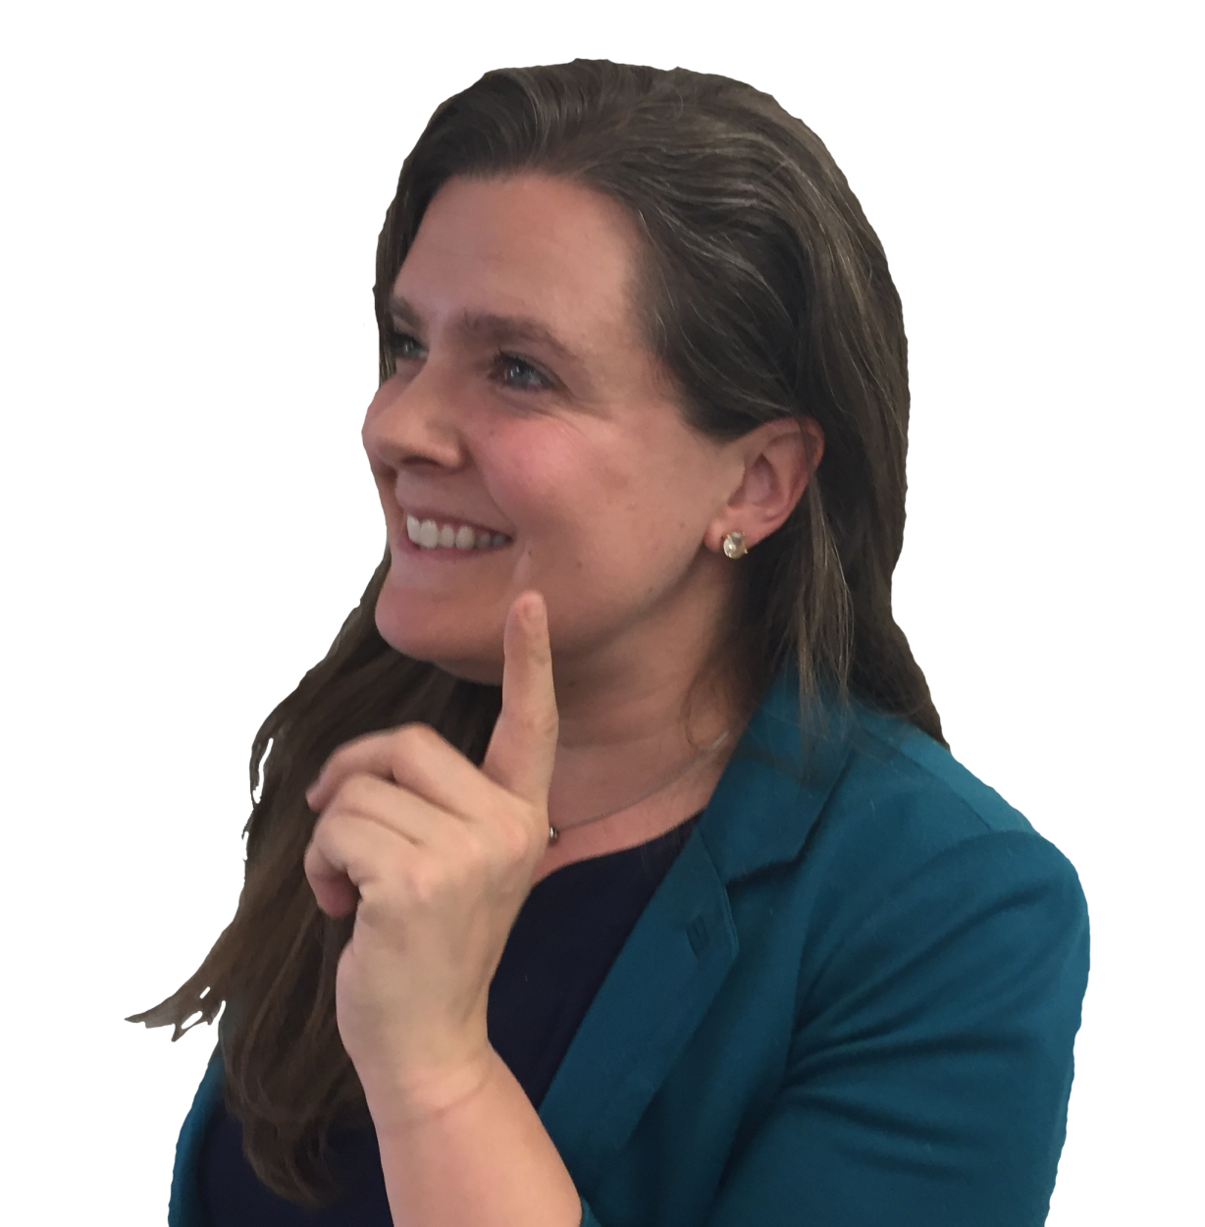
A Great Career Choice!
Positively impact the lives of youth
Help parents and educators
Flexible school schedule
Range of responsibilities
Variety of work settings

Slide 30

Questions?

Slide 31
References/Resources
Castillo, J.M., Curtis, M. J., Chappel, A., & Cunningham, J. (2011, February). School psychology 2010: Results of the national membership study. Paper presented at the annual convention of the National Association of School Psychologists, San Francisco, CA.
Fagan, T. K., & Wise, P. S. (2007). School psychology: Past, present, and future 3rd Ed. Bethesda: NASP.
Harrison, P., & Thomas, A. (2014). Best practices in school psychology VI. Bethesda: NASP.
U.S. Census Bureau (2010). Place of Birth of the Foreign-Born Population: 2009. Washington, DC: U.S. Census Bureau. www.census.gov/prod/2010pubs/acsbr09-15.pdf
U.S. Census Bureau (2010). Race and Hispanic Origin of the Foreign-Born Population in the United States: 2007. Washington, DC: U.S. Census Bureau. www.census.gov/prod/2010pubs/acs-11.pdf
U.S. News & World Report. Best Social Service Jobs. Retrieved from http://money.usnews.com/careers/best-jobs/school-psychologist

Slide 32
For more information, contact:
Texas Association of School Psychologists www.txasp.org
(trainers@txasp.org)
National Association of School Psychologists www.nasponline.org

Slide 33


