Slide 1
Fetal Alcohol Spectrum Disorders:
Diagnosis, Management and Prevention
Mohamad A. Sidani, MD, MS
Professor & Vice-Chair for Clinical Affairs
Dept. of Family & Community Medicine Meharry Medical College
Nashville, Tennessee
October 18, 2014
Texas Association of School Psychologists
22nd Annual Professional Development Conference

Slide 2
Presenter Disclosures
Mohamad Sidani, MD, MS
The following personal financial relationships with commercial interests relevant to this presentation existed during the past 12 months:
“No relationships to disclose”

Slide 3
Goals and Objectives
Review the diagnostic criteria for FAS and FASDs
Review the prevalence of FAS and FASD
Review some neurobehavioral problems associated with FASDs
Review intervention & treatment options of children with FAS/FASD
Review FASDs prevention/alcohol screening and brief intervention.

Slide 4
Barriers We Face as Providers
Diagnosis and Care of Children with FASDs
  Lack of training
  Uncertain about how to intervene if problem is found
  Fear of offending mother
  Belief that the harm is already done
Weisner C, Matzger H. Alcohol Clin Exp Res. 2003 Jul;27(7):1132-41;
Nevin AC et al. BMC Fam Pract. 2002;3:2.
Zoorob R, Aliyu MH, Hayes C. Alcohol. 2010 Jun;44(4):379-85.

Slide 5
Criteria for Diagnosing
Fetal Alcohol Syndrome (FAS)
With or w/o confirmed fetal exposure to alcohol, diagnosis requires documentation of:
All three dysmorphic facial features (smooth philtrum, thin vermillion border, small palpebral fissures)
Growth deficits
CNS abnormality
Bertrand J, Floyd RL, Weber MK. Guidelines for Identifying and Referring Persons with Fetal Alcohol syndrome. Morbidity and Mortality Weekly Review. October 28, 2005/54;1-10
www.cdc.gov
Notes:
Requires the 3 criteria

Slide 6
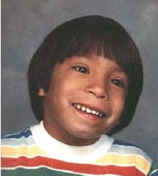
# 1. Facial Abnormalities Of FAS
  Smooth philtrum
  Thin vermillion
  Small palpebral fissures
Photo courtesy of Teresa Kellerman

Slide 7
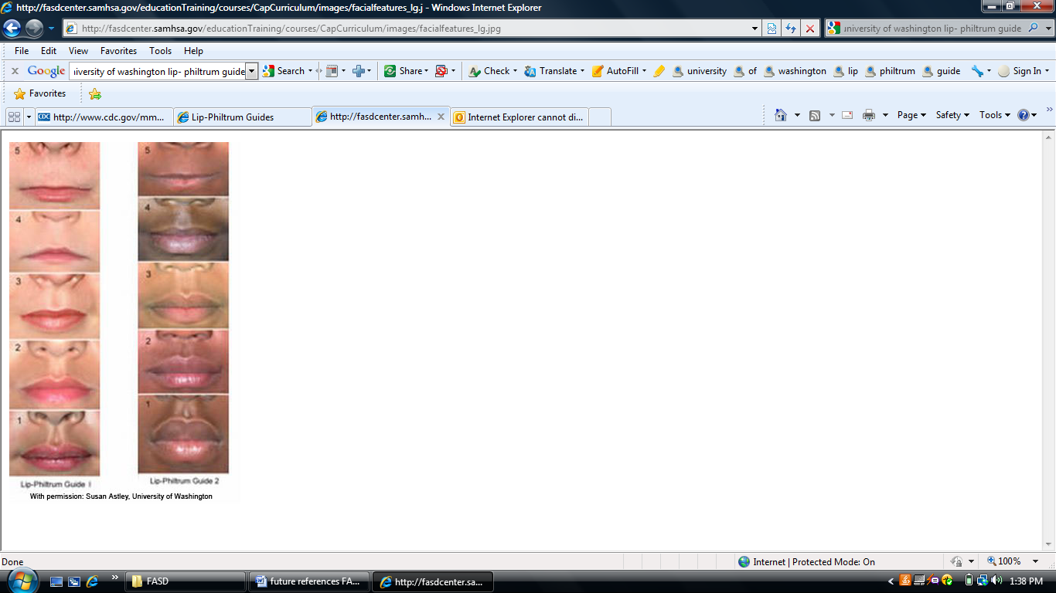
Lip-Philtrum Guide
Developed by University of Washington FAS Diagnostic & Prevention Network
Guide 1 – Caucasians
Guide 2 – African Americans
Back side provides face & height-weight tables from the FASD Diagnostic Guide (2004)
Order from: http://depts.washington.edu/fasdpn/htmls/order-forms.htm
http://fasdcenter.samhsa.gov/educationTraining/courses/CapCurriculum/competency2/facial2.cfm

Slide 8
Lip-Philtrum Guide
The Lip-Philtrum Guide reflects the full range of lip thickness and philtrum depth.
The Rank 3 : the mean (or 50th percentile).
The Rank 5 : (< 2.5th percentile) the typical expression of the smooth philtrum and thin upper lip seen in individuals with FAS
The Rank 1 : (> 97.5th percentile).. is an example of an individual with a very deep philtrum and full upper lip

Slide 9
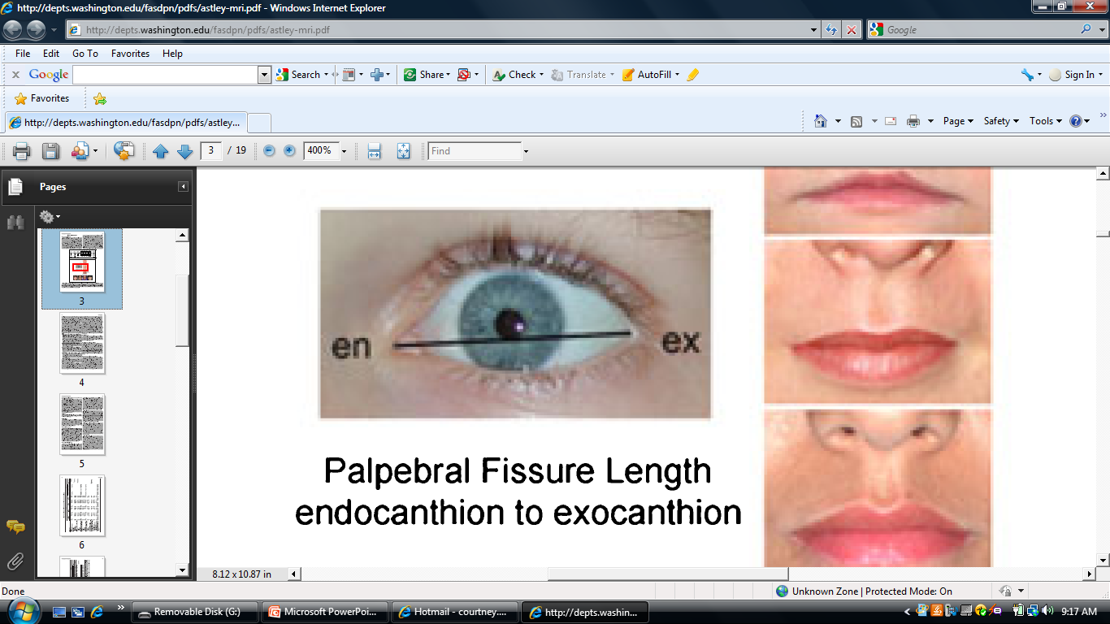
Measuring the Palpebral Fissures
Astley, et al. Magnetic Resonance Imaging Outcomes From a Comprehensive Magnetic Resonance Study of Children With Fetal Alcohol Spectrum Disorders. Alcoholism: Clinical and Experimental Research, Oct 2009.

Slide 10
PFL Measurement
Sliding Digital Calipers: The gold standard not safe to measure a person’s eye with a sliding digital caliper.
Hand-held Ruler: used the most; inaccurate
Software: FAS Facial Photographic Analysis Software measures PFL from a photograph.
http://depts.washington.edu/fasdpn/

Slide 11
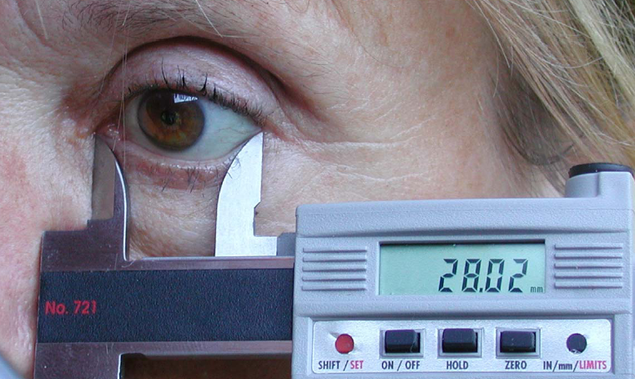
http://depts.washington.edu/fasdpn/pdfs/pfl-software-accuracy.pdf
Sliding Digital Calipers

Slide 12
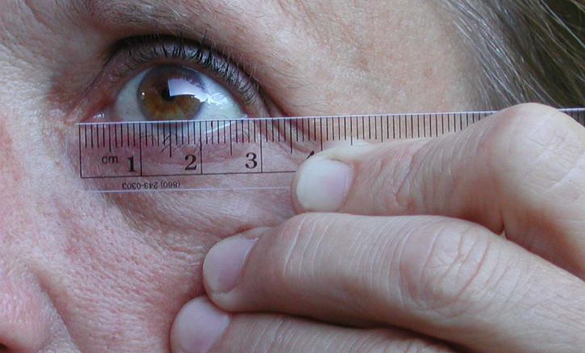
http://depts.washington.edu/fasdpn/pdfs/pfl-software-accuracy.pdf
Hand-held Ruler

Slide 13
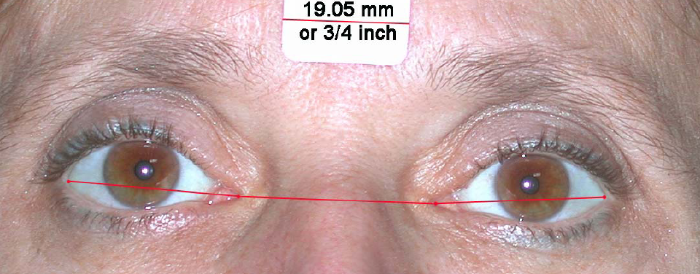
http://depts.washington.edu/fasdpn/pdfs/pfl-software-accuracy.pdf
FAS Facial Photographic Analysis Software

Slide 14
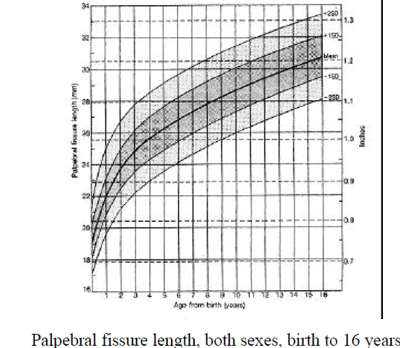
Diagnostic Guide for Fetal Alcohol Syndrome and Related Conditions The 4-Digit Diagnostic Code Second Edition FAS Diagnostic and Prevention Network University of Washington.1999

Slide 15
Dysmorphic Facial Features FAS
Clinical feature | Criteria
Shortened palpebral fissures | ≤10th percentile for age and racial norms
Smooth philtrum | Score of 4 or 5 on Lip-Philtrum Guide
Thin vermilion border of upper lip | Score of 4 or 5 on Lip-Philtrum Guide

Slide 16
Smooth Philtrum
Occurs also in:
  Cornelia de Lange syndrome
  Floating-Harbor syndrome
  Geleophysic dysplasia
  Opitz syndrome
  Toluene embryopathy
  Fetal Alcohol Syndrome. Guidelines for Referral and Diagnosis. CDC. May 2005

Slide 17
Thin Vermillion Border
Occurs also in:
  Miller-Dieker (Lissencephaly) syndrome
  Fetal Valproate syndrome
  Geleophysic dysplasia
  Cornelia de Lange syndrome
  Toluene embryopathy
Fetal Alcohol Syndrome. Guidelines for Referral and Diagnosis. CDC. May 2005

Slide 18
Short palpebral Fissure
  Occurs also in:
    Campomelic dysplasia
    DiGeorge sequence
    Dubowitz syndrome
    Duplication 10q sequence
    Duplication 15q sequence
    FG syndrome
    Maternal phenylketonuria (PKU)
    Oculodentodigital syndrome
    Opitz syndrome
    Trisomy 18 syndrome
    Williams syndrome
    Velocardiofacial syndrome
    Toluene embryopathy

Slide 19

Photo courtesy of the University of Louisville Fetal Alcohol Spectrum Disorders (FASD) Clinic - Weisskopf Child Evaluation Center, and the FASD Southeast Regional Training Center at Meharry Medical College Department of Family and Community Medicine: FASDsoutheast.org
Any use of this photo requires written permission from the University of Louisville FASD Clinic - Weisskopf Child Evaluation Center and the proper acknowledgement as written in this caption.

Slide 20

Photo courtesy of the University of Louisville Fetal Alcohol Spectrum Disorders (FASD) Clinic - Weisskopf Child Evaluation Center, and the FASD Southeast Regional Training Center at Meharry Medical College Department of Family and Community Medicine: FASDsoutheast.org Any use of this photo requires written permission from the University of Louisville FASD Clinic - Weisskopf Child Evaluation Center and the proper acknowledgement as written in this caption.

Slide 21
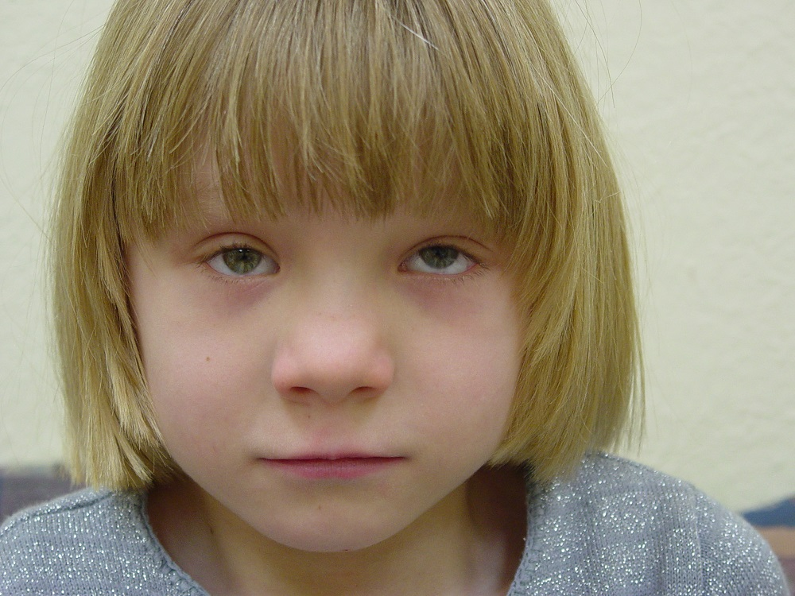
Photo of a 6-year old child with FAS.
Courtesy of the Great Lakes FASD Regional Training Center.
Notes:
The following three photos are shared with us by our counterpart RTC. Their PI, Dr. David Wargowski, is a geneticist.
When using the photos, please cite as “Courtesy of the Great Lakes FASD Regional Training Center”.

Slide 22
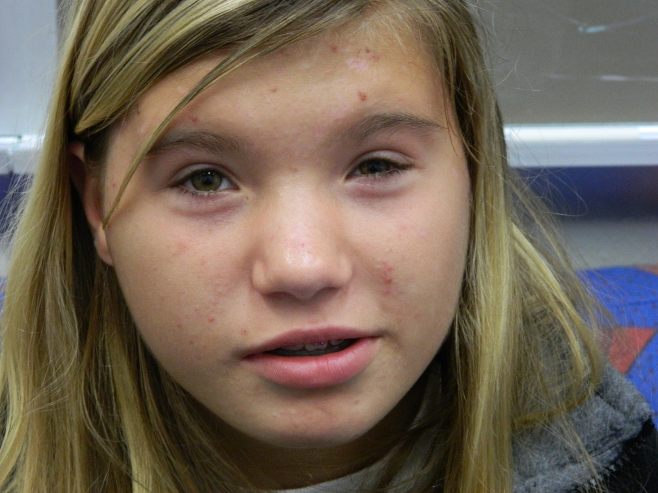
Photo of a 13-year old child with FAS. Courtesy of the Great lakes Regional Training Center.

Slide 23
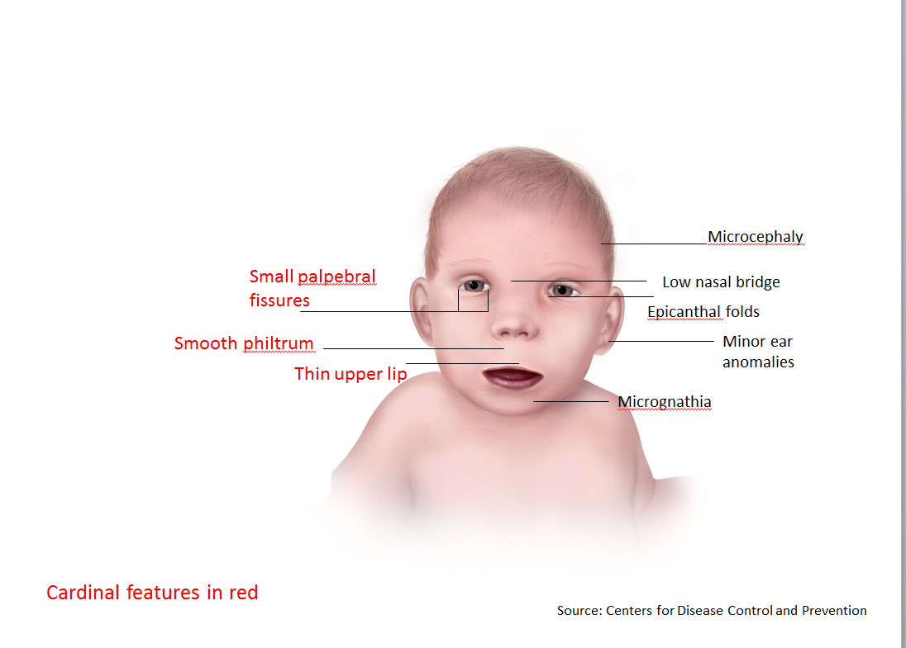

Slide 24
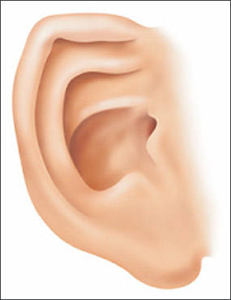
Characteristic features of an ear of a child with fetal alcohol spectrum disorders. Note the underdeveloped upper part of the ear parallel to the ear crease below (“railroad track” appearance).
Am Fam Physician. 2005 Jul 15;72(2):279-285

Slide 25
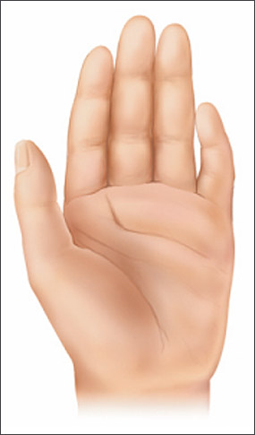
Characteristic features of a hand of a child with fetal alcohol spectrum disorders. Note the curved fifth finger (clinodactyly) and the upper palmar crease that widens and ends between the second and third fingers (“hockey stick” crease).
Am Fam Physician. 2005 Jul 15;72(2):279-285

Slide 26
#2. Growth Deficits in FAS
Timing
  Prenatal or Postnatal
  At any one point
Degree
  ≤ 10th percentile adjusted for age, sex, gestational age, and race or ethnicity
Height or Weight

Slide 27
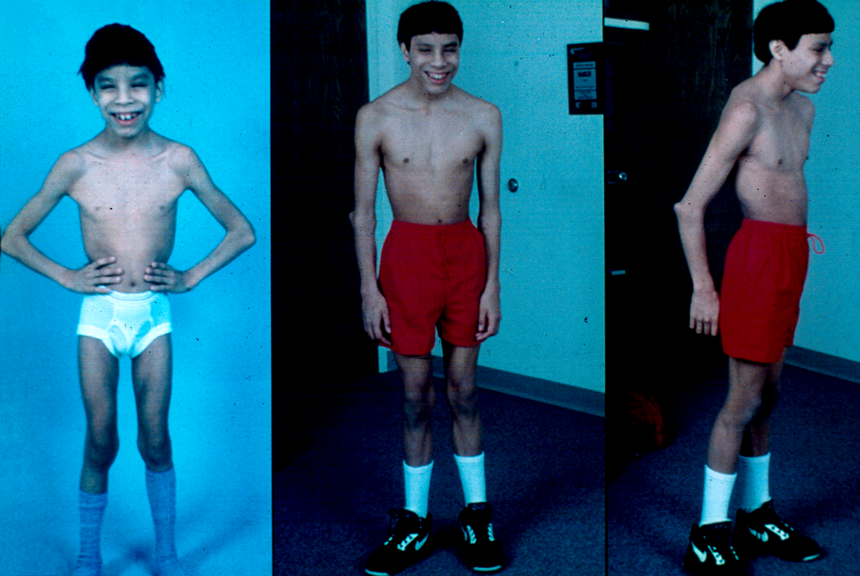
Courtesy of the UCLA RTC
UCLA

Slide 28
#3. CNS Abnormalities of FAS
Structural
OR
Neurological
OR
Functional Abnormality
    Bertrand J, Floyd RL, Weber MK. Guidelines for Identifying and Referring Persons with Fetal Alcohol syndrome. Morbidity and Mortality Weekly Review. October 28, 2005/54;1-10

Slide 29
#3. CNS Abnormalities of FAS
Structural
  Head circumference ≤ 10% (adjusted for age, sex) (or ≤3rd percentile for children whose height and weight are ≤10th percentile)
  OR
  Clinically significant brain abnormalities observed through imaging (reduction in size or change in shape of corpus callosum, cerebellum, hippocampus, or basal ganglia)
    Bertrand J, Floyd RL, Weber MK. Guidelines for Identifying and Referring Persons with Fetal Alcohol syndrome. Morbidity and Mortality Weekly Review. October 28, 2005/54;1-10

Slide 30
#3. CNS Abnormalities of FAS
Neurological
  Neurological problems not due to a postnatal insult or fever
  OR
  other soft neurological signs outside normal limits

Slide 31
#3. CNS Abnormalities of FAS
Functional Abnormality: Performance substantially below that expected for an individual’s age, schooling, or circumstances, as evidenced by:
  Global cognitive or intellectual deficits (or significant developmental delay in younger children) with performance below the 3rd percentile (2 standard deviations below the mean for standardized testing)
OR

Slide 32
#3. CNS Abnormalities of FAS
  Functional deficits (<16th percentile) in at least 3 domains:
    cognitive or developmental deficits or discrepancies
    executive functioning deficits
    motor functioning delays
    problems with attention or hyperactivity
    social skills
    other, such as sensory problems, pragmatic language problems, memory deficits, etc.

Slide 33
Age Effect
Cognitive deficits and behavioral disorder typically become more apparent in school-aged children with FASD and usually persist into adolescence and adulthood
Facial findings among the subset with FAS may become less characteristic with age.

Slide 34
Incidence of FAS
Comparable with or higher than rates for other common developmental disabilities (Down’s syndrome, spina bifida)
0.2 to 1.5 cases of FAS per 1,000 live births in the US
Approximately 4 million infants are born in the US per year
An estimated 1,000--6,000 are born with Fetal Alcohol Syndrome
CDC. MMWR Morb Mortal Wkly Rep 2002;51:433-435.

Slide 35
Economic Burden
FAS alone costs the United States > $ 4 billion annually in direct and indirect costs.
Lifetime health cost for an individual with FAS was estimated at is $ 2.0 million in 2002.
www.cdc.gov

Slide 36
What are FASDs?
“Fetal Alcohol Spectrum Disorder” is NOT a diagnostic category, but rather an umbrella term describing a range of effects that can occur in a person whose mother drank alcohol during pregnancy”
Bertrand J, Floyd RL, Weber MK. MMWR. October 28, 2005 / 54;1-10.

Slide 37
FASD prevalence
We do not know exactly how many people have an FASD.
Scientists believe that there are at least three times as many cases of FASDs as FAS

Slide 38
FASDs Distribution
FASDs affect every segment of the population.
All racial groups and economic classes are affected by FASDs.
Social, economic and environmental factors all contribute to the higher rates of FASDs in some populations.
Fetal Alcohol Spectrum Disorders handbook. Center for Disabilities. Sanford School of Medicine of The University of South Dakota. www.usd.edu/cd

Slide 39
FASDs Distribution
Some groups have been found to have higher rates of FAS/FASDs:
  Disadvantaged groups, some American Indian/Alaska Native groups, and other minorities.
  Children in foster care.
  Youth in juvenile justice system.
  CDC Diagnostic Guidelines, 2004

Slide 40
FASDs Diagnostic Criteria
The term FASDs is not meant for use as a clinical diagnosis.
Guidelines were developed for FAS only.
CDC and its partners are working to put together diagnostic criteria for other FASDs, such as ARND. Clinical and scientific research on these conditions is going on now.
www.CDC.gov

Slide 41
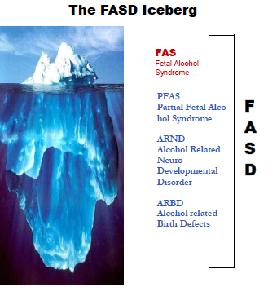

Slide 42
Types of FASDs: FAS
Fetal Alcohol Syndrome (FAS): The severe end of the FASD spectrum..
www.CDC.gov

Slide 43
Types of FASDs: ARND
Alcohol-Related Neurodevelopmental Disorder (ARND):
  Intellectual disabilities and problems with behavior and learning.
  poor performance at school, difficulties with math, memory, attention, judgment, and poor impulse control.
www.CDC.gov

Slide 44
Types of FASDs: ARBD
Alcohol-Related Birth Defects (ARBD): People with ARBD might have problems with the heart, kidneys, or bones or with hearing. They might have a mix of these.
www.CDC.gov

Slide 45
Partial FAS (IOM, Hoyme Criteria)
Partial FAS With or without Confirmed Maternal Alcohol Exposure:
  Documentation of 2 of the three dysmorphic facial features (smooth philtrum, thin vermillion border, small palpebral fissures)
  Documentation of either growth deficits or CNS abnormality
  Hoyme, Eugene. Pediatrics 2005;115;39

Slide 46
ARND (IOM, Hoyme Criteria)
ARND (diagnosis requires 1 and 2):
  Confirmed maternal alcohol exposure
  CNS - at least one of:
    Structural brain abnormalities
    Head circumference ≤10th percentile
    Evidence of a complex pattern of behavioral or cognitive abnormalities inconsistent with developmental level that cannot be explained by genetic predisposition, family background, or environment alone.
  Hoyme, Eugene. Pediatrics 2005;115;39

Slide 47
ARBD (IOM, Hoyme Criteria)
All three Criteria
  Confirmed maternal alcohol exposure.
  Two or more of FAS facial features:
  Congenital structural defects > 1category (≥2 required if only minor abnormalities):
    Cardiac anomalies: ASD, VSD, AGV, Conotruncal defects
    Skeletal anomalies :Radioulnar synostosis, Vertebral segmentation defects, Large joint contractures, Scoliosis.
  Hoyme, Eugene. Pediatrics 2005;115;39

Slide 48
ARBD (IOM, Hoyme Criteria)
  Renal anomalies: Aplastic, dysplastic, or hypoplastic kidneys; Ureteral duplication; Horseshoe kidneys.
  Ocular anomalies:Strabismus, Ptosis, Retinal vascular anomalies, Optic nerve hypoplasia.
  Ears: Conductive or Sensorineural hearing loss.
  Minor abnormalities: Hypoplastic nails, Short fifth fingers, Camptodactyly, Clinodactyly of fifth fingers, Pectus carinatum or excavatum, Hockey-stick palmar creases, Refractive errors, Railroad-track ears.
  Hoyme, Eugene. Pediatrics 2005;115;39

Slide 49
Characteristic features of a hand of a child with fetal alcohol spectrum disorders. Note the curved fifth finger (clinodactyly) and the upper palmar crease that widens and ends between the second and third fingers (“hockey stick” crease).
Am Fam Physician. 2005 Jul 15;72(2):279-285

Slide 50
The 4-Digit Diagnostic Code
The four digits reflect the magnitude of expression of four key diagnostic features of FAS in the following order:
  growth deficiency,
  the FAS facial phenotype,
  brain dysfunction
  gestational alcohol exposure
The magnitude of expression of each feature is ranked independently on a 4-point Likert scale.
Diagnostic Guide for Fetal Alcohol Syndrome and Related Conditions The 4-Digit Diagnostic Code Second Edition FAS Diagnostic and Prevention Network University of Washington.1999

Slide 51
Hereditary Effect
FASD is not inherited
There seems to be a genetic predisposition to problem drinking.
Twin studies document similar outcomes in identical twins and different outcomes in non-identical twins.
Pediatrics 2005;115:39-47.

Slide 52
Fetal Alcohol Exposure Effects on Neurobehavior

Slide 53
Fetal Alcohol Exposure Effects on Neuro-behavior
FASDs are the leading cause of mental retardation
FASDs are the only preventable causes of mental retardation.
Not all people with FASDs have mental retardation. In fact the IQ range from 29-140
www.cdc.gov/ncbddd/fasd/videos/Iyal/long/Iyal_long.html

Slide 54
Psychiatric/Behavioral
  Verbal Learning: People with FASDs have problems with verbal learning, different than in Down syndrome.
    FASDs affect people's ability to initially encode in memory, -but once encoded, recall is as good as for anyone else.
    Down syndrome, both storage and recall are impaired.
  Visual-Spatial Learning: difficulty with learning spacial relationships between objects and with mathematics.

Slide 55
Psychiatric/Behavioral
Attention: (hallmark of prenatal alcohol exposure).
  So common amongst people with FASDs that they are often misdiagnosed with attention deficit disorders.
  People with classic attention deficit disorder tend to have difficulty focusing and maintaining attention.
  People with FASDs have fewer problems with focusing and maintaining attention, but more trouble shifting attention from one task to another (what researchers call "set shifting").

Slide 56
Psychiatric/Behavioral
Reaction time: One of the key effects of FASDs:
  Slow reaction time
  Reduced brain processing speed.
Both of these affect overall intelligence by limiting the brain's capacity to take in information rapidly, particularly in a setting like an ordinary classroom.

Slide 57
Psychiatric/Behavioral
Executive Function: One of its cruelest effects:
  The ability to plan for the future and to change behavior in response to the effects of previous actions.
  Are often incapable of learning from experience and may repeat behaviors over and over despite negative results.

Slide 58
Psychiatric/Behavioral
Executive Function (Cont’d):
  Cannot put together a sequence of actions in order to achieve a goal-for example, taking the steps necessary to do homework adequately or to pay a bill on time.
  Get "stuck" on certain things and cannot keep the whole process in mind while carrying out the steps needed to complete it.

Slide 59
Psychiatric/Behavioral
Impulsive:
  Often impulsive and may react without thinking.
  Often diagnosed with conduct disorder and/or oppositional defiant disorder and may have frequent run-ins with law enforcement as they appear to be willfully disobeying authorities and actively seeking repeat punishment.
  FASDs also appear to make people more likely to lie.

Slide 60
Psychiatric/Behavioral
Socialization:
  Difficulties recognizing social cues. Often "can't take a hint," or recognize non-verbal suggestions.
  Intrusiveness: excessive body contact
  They may be overly demanding of attention and may lack empathy towards others. Lack of stranger anxiety
  Eager-to-please and easily lead. They may be preyed upon and pushed to commit crimes.
  Tendency towards sexual promiscuity.

Slide 61
Kindergarten – Sixth Grade
  Easily influenced by others
  Memory loss and retrieval problems. Needs things repeated multiple times and still may not retain information.
  Lying, stealing, or disobedient
  Problems separating fantasy from reality, having a different perception of reality
  Temper tantrums
  Delayed physical, academic, and/or social development
  Silence, retreating from situations
  Inappropriate social behavior

Slide 62
Beyond Early Childhood
Difficulties Socializing
  Maintaining Friendships
  Depression and Anxiety
  Inappropriate Sexuality

Slide 63
Middle School/Junior High
  Self-centered (act younger than stated age)
  Criminal activity
  Poor reasoning skills
  Cognitive problems from previous section do not improve (memory, recall, reality, etc.)
  Poor motivation, low self-esteem, depression
  Sexually active, drug or alcohol use
  Lacks time management skills, no concept of time

Slide 64
Actual Age: 18
Expressive Language ----------------------------------- 20
Comprehension ------- 6
Money, time concepts ------- 8
Emotional maturity ---- 6
Physical maturity ---------------------------------- 18
Reading Ability ------------------------------- 16
Social Skills ---------------- 7
Living Skills --------------------- 11
Vineland Adaptive Behavior Scales
Notes:
A person with FASD or other brain differences may have wide variances in their abilities. This is an example from the Vineland Adaptive Behavior Scales, which is an assessment of developmental age. These scored belong to an 18 year old woman with FASD. Her expressive language is higher than her chronological age, so she speaks very well. Her reading ability is at age 16, which is close to typical. However, her comprehension level is that of a six year old. Her vocabulary is good and she can read well, but she doesn’t understand what she is reading. Her emotional maturity is also at the level of a six year old. When she responds to situations like a first-grader, that is because she is acting according to her developmental age in that area.

Slide 65
…. Even Beyond Early Childhood
Disrupted Schooling
  43% of teens with FASDs are at high risk of having school interrupted by suspension, expulsion, or from dropping out
Conduct Problems
  Antisocial Behaviors
  Inability to follow rules, lying, and stealing
  GOAL
  Independent Living

Slide 66
Secondary Disabilities
  Mental health problems-more than 90%
  Alcohol and other drug problems-35%
  Disrupted school experiences->60%
  Juvenile justice 60%
  Juvenile confinement 40%
Streissguth, A. (1997). Fetal Alcohol Syndrome: A Guide for Families and Communities. Baltimore: Brookes Publishing. ISBN 1-55766-283-5
Notes:
Left untreated, secondary disabilities are rampant. These are individuals whose primary brain disabilities have not been recognized, and thus no accommodations apparently have been provided.

Slide 67
Co-occurring conditions in FASD
Attention-Deficit/Hyperactivity Disorder (ADHD)
Oppositional Defiant Disorder (ODD)
Conduct Disorder (CD)
Reactive Attachment Disorder (RAD)
Sleep Disorders
Schizophrenia
Depression
Bi-polar disorder
Substance use disorders
Post-Traumatic Stress Disorder (PTSD)

Slide 68
Protective Factors
Living in a stable and nurturing home for over 72% of life
Being diagnosed with FAS before age six
Never having experienced violence
Remaining in each living situation for at least 2.8 years
Experiencing a "good quality home" from age 8 to 12 years old
Having been found eligible for developmental disability (DD) services
Having basic needs met for at least 13% of life
Having a diagnosis of FAS (rather than another FASD condition)
Streissguth, A. (1997). Fetal Alcohol Syndrome: A Guide for Families and Communities. Baltimore: Brookes Publishing. ISBN 1-55766-283-5.

Slide 69
Work UP
Gather historical information about prenatal alcohol exposure.
A family history of similarly affected individuals, learning disabilities, mental retardation, psychiatric disorders, and birth defects should be sought.
A careful physical examination should be performed parameters, and major or minor anomalies.
Hoyme, Eugene. Pediatrics 2005;115;39

Slide 70
Work Up
Psychologic testing: specifically assessment of the learning and behavioral characteristics
Any inconsistency with a FASDs diagnosis, refer to a dysmorphologist/ clinical geneticist.
Hoyme, Eugene. Pediatrics 2005;115;39

Slide 71
Referral
A child or individual should be referred for full FAS evaluation when:
  There is confirmed significant prenatal alcohol use
  Prenatal alcohol exposure is unknown, if:
    Any report of concern by a parent or caregiver
    All three facial features are present
    One or more facial features, and growth deficits
    One or more facial features with one or more CNS abnormalities
    One or more facial features with growth deficits and one or more CNS abnormalities.
Fetal Alcohol Syndrome: Guidelines for Referral and Diagnosis. May 2005

Slide 72
Refer Where?
Referral to a multidisciplinary team (i.e., dysmorphologist/clinical geneticist, psychologist, developmental pediatrician, mental health professional, social worker, and educational specialist).
Even in patients who clearly have met diagnostic criteria, referral allows complete assessment for an individualized management plan
Am Fam Physician. 2005;72:279-82, 285

Slide 73
AAP Fact Sheets
Pediatricians should consider FASDs when evaluating children with developmental problems, behavioral concerns, or school failure.
These diagnoses should particularly be considered for children in foster care, especially if drug or alcohol use by a parent was a contributing factor.

Slide 74
AAP Fact Sheets
Children with FASDs need a pediatric medical home to provide and coordinate care and ensure necessary medical, behavioral, social, and educational services.

Slide 75
FASDs Interventions and Treatments
Prevention is first but for those cases that
were not prevented

Slide 76
Early Intervention
There is no cure for FASDs, but research shows that early intervention treatment services can improve a child's development.

Slide 77
Intervention Strategies
Appropriate developmental services
Appropriate educational services (8 Magic Keys, Socio-cognitive habilitation/math interactive learning experience)
Advocacy in multiple settings, specifically SCHOOL and WORKPLACE
Treatment of co-occurring conditions (including medication management)
Social skills training

Slide 78
Behavior and Education Therapy
Friendship training: improves children's social skills and reduce problem behaviors.
Specialized math tutoring
Executive functioning training
Parent-child interaction therapy decreases parent distress and child behavior problems.
Parenting and behavior management training improves caregiver comfort, meet family needs, and reduce child problem behaviors.
http://www.cdc.gov/ncbddd/fasd/treatments.html
Notes:
Behavior and Education Therapy
Behavior and education therapy can be an important part of treatment for children with FASDs. Although there are many different types of therapy for children with developmental disabilities, only a few have been scientifically tested specifically for children with FASDs.
Following are behavior and education therapies that have been shown to be effective for some children with FASDs:
Friendship training
Many children with FASDs have a hard time making friends, keeping friends, and socializing with others. Friendship training teaches children with FASDs how to interact with friends, how to enter a group of children already playing, how to arrange and handle in-home play dates, and how to avoid and work out conflicts. A research study found that this type of training could significantly improve children's social skills and reduce problem behaviors.²
Specialized math tutoring
A research study found that special teaching methods and tools can help improve math knowledge and skills in children with FASDs.³
Executive functioning training
This type of training teaches behavioral awareness and self-control and improves executive functioning skills, such as memory, cause and effect, reasoning, planning, and problem solving.
Parent-child interaction therapy
This type of therapy aims to improve parent-child relationships, create a positive discipline program, and reduce behavior problems in children with FASDs. Parents learn new skills from a coach. A research study found significant decrease in parent distress and child behavior problems.
Parenting and behavior management training
The behavior and learning problems that affect children with FASDs can lead to high levels of stress for the children's parents. This training can improve caregiver comfort, meet family needs, and reduce child problem behaviors.

Slide 79
Parent Training
Parent training has been successful in:
  educating parents about their child's disability
  Educating parents ways to teach their child many skills and help them cope with their FASD-related symptoms.
  Done in groups or with individual families.
  Offered by therapists or in special classes.
  http://www.cdc.gov/ncbddd/fasd/treatments.html

Slide 80
Helpful Parenting Tips
Concentrate on your child's strengths and talents
Accept your child's limitations
Be consistent with everything (discipline, school)
Use concrete language and examples
Use stable routines that do not change daily
Keep it simple
Be specific-say exactly what you mean
Structure your child's world to provide a foundation for daily living
  Chttp://www.cdc.gov/ncbddd/fasd/treatments.html DC

Slide 81
Helpful Parenting Tips
Use visual aides, music, and hands-on activities to help your child learn
Use positive reinforcement often (praise, incentives)
Supervise: friends, visits, routines
Repeat, repeat, repeat
  http://www.cdc.gov/ncbddd/fasd/treatments.html

Slide 82
Helpful Parenting Tips
For children 3 years old or older, contact your local public school system.
If you’re not sure whom to contact, call the National Dissemination Center for Children with Disabilities (NICHCY) at 1-800-695-0285 . Or visit the NICHCY website; select your state and look for the heading "Programs for Children with Disabilities: Ages 3 through 5."

Slide 83
Medication
No medications have been approved specifically to treat FASDs.
But, several medications can help improve some of the symptoms of FASDs.
  Stimulants
  Alpha-2 adrenergic agonists
  Antidepressants
  Neuroleptics
  Anti-anxiety drugs

Slide 84
Psychopharm - reviews
Systematic review; 10 intervention studies and unable to obtain 3 studies.
Unable to use meta-analysis since studies examined different interventions and outcomes.
Studies included stimulants (Methylphenidate, Dextroamphetamine, and Pemoline) and Cognitive Control Therapy.
Limited scientific evidence regarding efficacious interventions for children and youth with a FASDs.
Child Care Health Dev. 2007 Jul;33(4):389-97
Notes:
Child Care Health Dev. 2007 Jul;33(4):389-97; discussion 398-400.
Research-based interventions for children and youth with a Fetal Alcohol Spectrum Disorder: revealing the gap.
Premji S, Benzies K, Serrett K, Hayden KA.
Source
Faculty of Nursing, University of Calgary, Calgary, Canada. premjis@ucalgary.ca
Abstract
BACKGROUND:
Alcohol use during pregnancy can result in a continuum of effects including growth deficits, dysmorphology and/or complex patterns of behavioural and cognitive difficulties that influence an individual's functioning throughout their lifespan. We conducted a systematic review to identify research-based interventions for children and youth with a Fetal Alcohol Spectrum Disorder and areas for future study.
METHODS:
We identified the substantive literature by searching 40 peer-reviewed and 23 grey literature databases, as well as reference lists. We hand-searched eight relevant journals, and undertook a systematic search of Internet sites and review of reports and documents received from key stakeholders. Two reviewers independently assessed eligibility and quality, and extracted data. Given the small number of studies that met all inclusion criteria, both experimental and quasi-experimental studies were included.
RESULTS:
Ten intervention studies were identified, of which three were experimental or quasi-experimental, and four were non-experimental. Despite multiple attempts, three studies (two in foreign languages and one unpublished) could not be acquired. A meta-analysis could not be undertaken because the included studies examined different interventions or outcomes. Interventions targeted in the included studies were as follows: (i) psychostimulant medications (methyphenidate, pemoline and dextroamphetamine); and (ii) Cognitive Control Therapy. The identified studies were limited by very small sample sizes and weak designs.
CONCLUSION:
There is limited scientific evidence upon which to draw recommendations regarding efficacious interventions for children and youth with a Fetal Alcohol Spectrum Disorder. Clinicians, researchers, service providers, educators, policy makers, affected children and youth and their families, and others need to urgently collaborate to develop a comprehensive research agenda for this population.

Slide 85
Psychopharm - reviews
Literature review; 12 studies.
Methodological weaknesses.
2 RCTs: some benefit from stimulants.
Limited good quality evidence for specific interventions in FASD.
BMC Pediatrics 2009, 9:35 doi:10.1186/1471-2431-9-35

Slide 86
Psychopharm
Chart review in child development unit over prior 7 years. 22 patients with 66 med trials
FAS, PFAS, ARND ages 3.5 to 17 years with confirmed in utero exposure.
Groups of meds:
1. Stimulants 63% responded well
2. Mood stabilizers 88%
3. SSRI’s 82%
4. Antipsychotics 83%
Mental Health Aspects of Developmental Disabilities, Vol 4(4), Oct-Dec 2001, 148-155.

Slide 87
Psychopharm: ADHD and FASD
ADHD is diagnosed in 94% individuals with heavy prenatal alcohol exposure.
Some evidence ADHD in FASD is clinical subtype
Weak evidence Dextroamphetamine (Dexedrine®) may be more effective than Methylphenidate.
Limited scientific evidence on effective interventions for children with FASD and ADHD.
Neuropsychiatric Disease and Treatment 2010:6 509–515

Slide 88
Psychopharm: Executive Function
Literature review
EF deficits consistent in disorders such as ADHD, ASD and FASD than in the other disorders
Executive System uses Dopamine as main neurotransmitter
Dopamine agonists (stimulants) and antagonists (neuroleptics) commonly used to tx EF
SSRI’s not very helpful
J Can Acad Child Adolesc Psychiatry, 21:3, August 2012

