Slide 1
Fasd prevention strategies
Sandra J. Gonzalez, MSSW, LCSW
Instructor
Baylor College of Medicine
Department of Family and Community Medicine
Houston, TX

Slide 2
Amount of Alcohol
Follow-up study.
Neuropsychological testing in four Danish cities 2003– 2008. IQ, attention and Executive Function
A cohort of 1628 women and their children 5 years of age
BJOG 2012;119:1180–1190.

Slide 3
Amount of Alcohol
No significant association of low to moderate average weekly alcohol consumption (1-4;5-8/wk), and any binge drinking, during early to mid pregnancy with the neurodevelopment of children at the age of 5 years.
High levels of alcohol (> 9 or more drinks per week), was associated with lower attention span amongst five year olds.
BJOG 2012;119:1180–1190.

Slide 4
Researchers’ Discussion
“To date, the scientific literature, including the present study, does not establish a safe level of alcohol consumption during pregnancy.”
As alcohol is a known teratogen, it remains the most conservative advice for women to abstain from alcohol during pregnancy.”
BJOG 2012;119:1180–1190.

Slide 5
No known safe amount of alcohol to drink while pregnant
Brain
Nerves
Brain
Stomach
Placenta
Fetus
Breast
Heart
Organs
Liver
Muscles
Kidneys

Slide 6
Alcohol and Pregnancy
Alcohol is a teratogen
Drinking during pregnancy can lead to sudden infant death syndrome and fetal alcohol spectrum disorders.
ACOG. Committee Opinion. Number 496. August 2011
CDC

Slide 7
Major Effects of Ethanol by Trimester of Pregnancy
The most prudent advice you can give to all women is to stop drinking before conception and to maintain abstinence through-out pregnancy and during breast feeding.
(UCLA RTC)

Slide 8
Alcohol and Breastfeeding
There is reduced milk consumption by infants of lactating women consuming alcohol.
Associated with altered postnatal growth, sleep pattern, and psychomotor patterns.
After breastfeeding is established, mothers should wait 3-4 hours after a single drink before breastfeeding
ACOG. Committee Opinion. Number 496. August 2011

Slide 9
The problem: Risky drinking
More than 80,000 people in the U.S. die each year due to alcohol-related causes
Third leading cause of death.
In 2006, cost out numbered tobacco and obesity resulting in $223.5 billion in lost productivity, health care, criminal justice, motor vehicle crashes, fetal alcohol syndrome, and fire and property damage (Bouchery et al., 2011).
There is no known safe level of drinking and alcohol causes 10 times as many deaths as it prevents (American Journal of Public Health, 2013).
Notes:
Risky drinking is any level of alcohol consumption that increases the risk of harm to a person’s health or well-being or that of others.
Risky drinking = excessive, unhealthy alcohol consumption
The Partnership for Prevention has ranked alcohol SBI fourth among all clinical preventive services in reducing the clinical burden of disease, injury and death in its cost effectiveness – ahead of hypertension, cholesterol, and colorectal screening.
Only below:
Discussion of daily aspirin use
Childhood immunizations
Smoking cessation

Slide 10
The Health and Social Effects of Risky Drinking
Immediate Effects |  | Long-Term Effects
Motor vehicle crashes | Assaults and sexual assaults | Gastritis | Liver cirrhosis
Pedestrian injuries | Child abuse and neglect | Hypertension | Cancer
Drowning | Property crimes | Cardiovascular disease | Pancreatitis
Unintended sex and pregnancy | Homicide | Fetal alcohol spectrum disorders | Diabetes
Alcohol poisoning | Suicide | Stroke | Neurologic disorders
Notes:
Not only can risky drinking further complicate chronic illness, it is also the largest single cause of lost productivity in the workplace.
Risky drinking patterns are of public health significance even in the absence of any current disorder in the individual user.

Slide 11
The response: Screening and brief intervention
Purpose of SBI:
Intended to meet public health goal of reducing harms and societal costs associated with risky drinking
Use a system’s approach to:
Incorporate alcohol SBI into day-to-day clinical practice
Identify barriers and facilitators to implementation
Identify methods to overcome barriers and create solutions
Evaluate the uptake of alcohol SBI in the clinics
Notes:
You can identify risky drinking within just a few minutes of talking with a health care provider.
Can help many patients reduce their alcohol consumption
Reimburseable

Slide 12
Rationale
Target for brief interventions is non-dependent risky drinker.
Should also screen, motivate, and refer those who are alcohol dependent.
Previous research demonstrates that brief intervention is effective in primary care practices.
The overall program is cost-effective and beneficial.
Effective although simple and brief.
Notes:
86% of people who engage in risky drinking do NOT have alcohol dependence. However, the bulk of harm associated with alcohol occurs among people who are not dependent.
Alcohol dependence occurs in about 4% of the general population while about 25% of people drink too much.
Approximately 92% of U.S. adults who drink excessively report binge drinking in the past 30 days.
More than half of the alcohol consumed by adults in the United States is in the form of binge drinks.

Slide 13
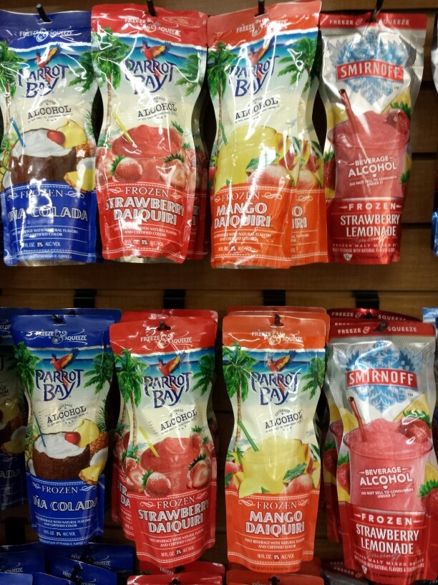
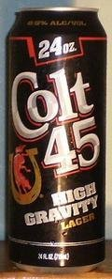
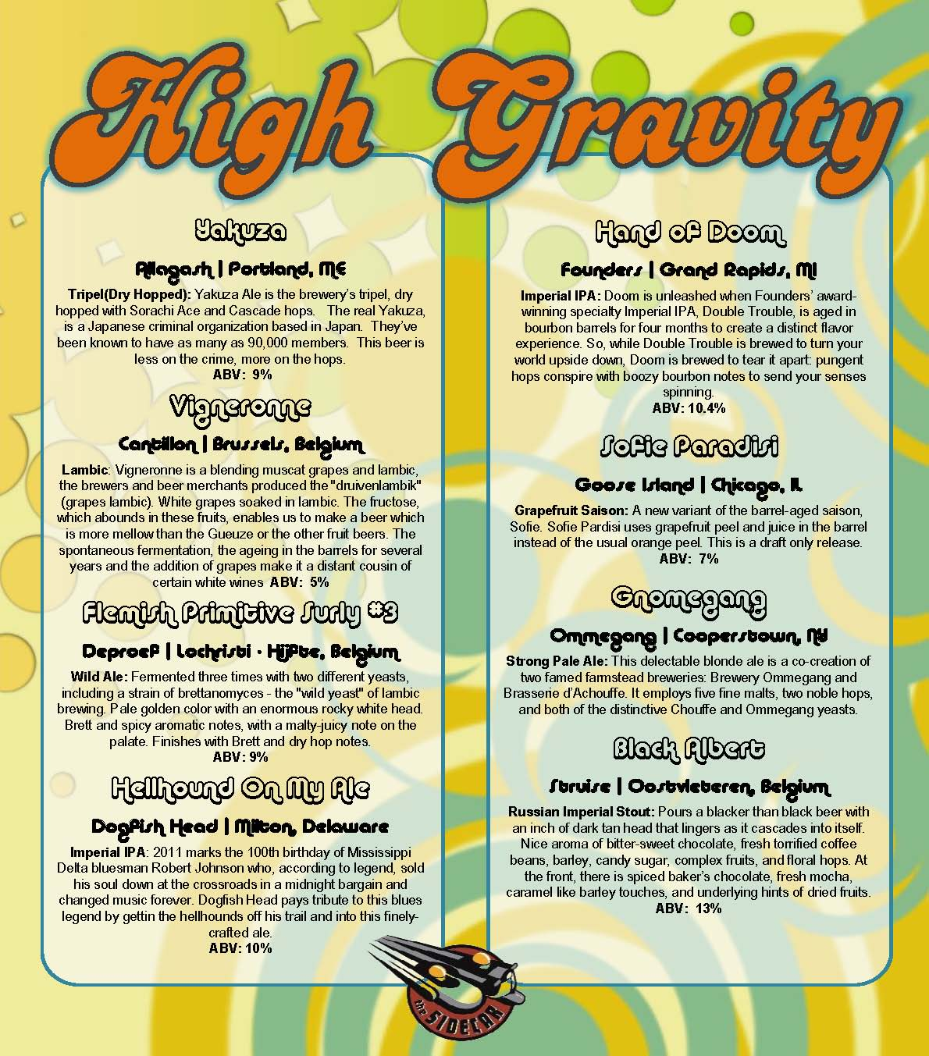
The Effect of Marketing

Slide 14
What is a standard drink?

Slide 15
Risky Drinking Levels for Healthy Adults
Healthy men ages 21-65 | No more than 4 drinks on any single day (*5 or more drinks consumed within 2 hours is binge drinking) No more than 14 drinks a week
All healthy women ages 21 and older Healthy men over age 65 | No more than 3 drinks on any single day (*4 or more drinks consumed within 2 hours is binge drinking) No more than 7 drinks a week
Adapted from: Planning and Implementing Screening and Brief Intervention for Risky Alcohol Use: A Step by Step Guide for Primary Care Practices. Available at: http://www.cdc.gov/ncbddd/fasd/alcohol-screening.html

Slide 16
Other considerations
Those taking prescription or OTC medications that may interact with alcohol, causing harmful reactions.
Those with medical conditions that may be worsened by alcohol (liver disease, pancreatitis).
Those who are driving, planning to drive, or participating in other activities requiring skill, coordination, and alertness.
Those where any drinking at all is considered risky:
Unable to control the amount they drink, including those who are dependent.
Women who are pregnant or might become pregnant.
Under the age of 21.

Slide 17
Screening Instruments
*Single question alcohol screen – “How many times in the past year have you had X (5 for men; 4 for women) or more drinks in a day?
*AUDIT 1-3 (US)
AUDIT (US)
CAGE – Primary care
RAPS4 – Emergency department
T-ACE – Ob/Gyn, primary care
TWEAK – Ob/Gyn, primary care, emergency department

Slide 18
The Alcohol Use Disorders Identification Test (AUDIT)
Notes:
The AUDIT 1-3 (US) and AUDIT (US) have been modified for the US standard drink (14grams rather than 10grams in the international version). See question #3 and replace with 5 or 4 instead of 6.

Slide 19
Protocol using AUDIT 1-3 (US) and AUDIT (US)
If using AUDIT 1-3 (US), Zone 1 is negative
Notes:
Step 1 – Assess alcohol consumption using single question or AUDIT 1-3 (US)
Step 2 – Determine risk – if negative on AUDIT 1-3 (US), will have conversation and/or give brochure on drinking limits
If positive, assess harm and dependence (using full AUDIT). If not likely dependent, brief intervention only. If likely dependent, brief intervention and referral.

Slide 20
Brochure

Slide 21
Brochure

Slide 22
Sample Brief Intervention Protocol
Raise subject: “If it’s okay with you, let’s talk about the health and wellness form you filled out today”
Provide feedback: “I am concerned about how your drinking may affect your health and possibly the health problem you came in for today.” “It is recommended that you consume no more than 3 drinks per day for women (7 per week) and 4 per day for men (14 per week).”
Assess readiness to change (show the scale): “On a scale of 0-10, how ready are you to cut back your use?” Enter Number Chosen
If >0: Proceed to plan
If 0: Select Unwilling: “What would have to happen for you to consider cutting back?” *If patient is unwilling BI will end here.
Notes:
Important to mention that exceeding EITHER daily or weekly limits puts them at risk.

Slide 23
Sample brief intervention protocol
Negotiate a plan:
“Let’s set a drinking goal, what do you think will work best for you?” (Try to make it within limits but keep it realistic)
Enter goal: # drinks per week and per day
Write down goal on handout and give to patient
“Can you think of anything that might get in the way of achieving your goal?”
Write down barriers in EMR and on handout
Set up a follow up appointment 4-6 weeks out
At follow up reassess goal and if patient needs further assistance

Slide 24
SAMHSA 2010 National Survey on Drug use and Health
57% women of childbearing age (15-44) currently drink
Among pregnant women (15-44)
9.4 percent reported current alcohol use
2.6 percent reported binge drinking
0.4 percent reported heavy drinking
Substance Abuse and Mental Health Services Administration, Results from the 2010 National Survey on Drug Use and Health: Summary of National Findings, NSDUH Series H-41, HHS Publication No. (SMA) 11-4658. Rockville, MD: Substance Abuse and Mental Health Services Administration, 2011.
Notes:
Current = at least one drink in past 30 days, Binge = 5+, heavy= 5+ on the same occasion on each of 5 or more days in the past 30 days

Slide 25
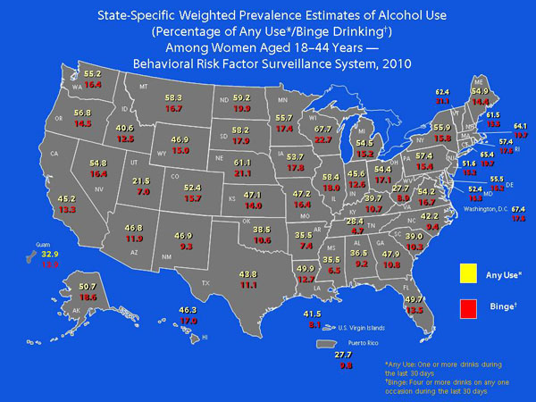

Slide 26
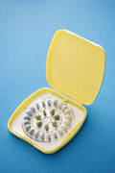
Start with the Basics!
Decrease unintended pregnancies
Initiate contraceptive efforts
Confirm proper and
consistent use
Example from Project CHOICES
Changing High-Risk AlcOhol Use &
Increasing Contraception Effectiveness Study
Photo: courtesy Dang, CDC.

Slide 27
Project CHOICES
4 motivational counseling sessions and a contraception consultation visit delivered over 12-14 weeks
At 3, 6, and 9 month follow-up, the odds for reducing the risk of an Alcohol Exposed Pregnancy (AEP) were 2-fold higher among women receiving the intervention as compared to the control group.
Floyd, et al. Preventing Alcohol-Exposed Pregnancies: A Randomized Controlled Trial American Journal of Preventive Medicine; January 2007; 32(1):1-10.
Notes:
Recruit non-treatment-seeking women at risk for AEP:
Fertile and 18-44 years of age
Sexual intercourse w/ a man in past 3 months
Using ineffective or no contraception
Drinking 8 or more drinks per week OR
Drinking 5 or more drinks on one or more days in last 3 months.
“Reduced” AEP risk: using effective contraception OR drinking below risky levels
71% still in study at 9-month follow-up
Both groups had reduced risk
More intervention women changed both behaviors
Not at risk by: intervention control
Alcohol 49% 40%
BC 56% 39%

Slide 28
Father’s Effect
To date, there is no physical link between a father’s drinking and FASDs.
However, a mother’s drinking behavior can be influenced by the drinking behaviors of those around her, including her partner.
http://www.usd.edu/medical-school/center-for-disabilities/upload/fasdhandbook.pdf

Slide 29
Alcohol Assessment: Frequency and Quantity
First ask: Do you drink alcohol, including beer, wine or distilled spirits?
On average, how many days per week do you drink alcohol?
On a typical day when you drink, how many drinks do you have?
What’s the maximum number of drinks you had on a given occasion in the last month?

Slide 30
How Much Do You Drink? Most Doctors Never Ask
A survey in 2011 of 166,753 adults (>18) from 44 states and DC found:
One in six adults said a health professional has ever discussed drinking with them.
Just 17% of pregnant women at the time of survey said they had ever been asked about drinking.
USA Today. January 7, 2014

Slide 31
Barriers We Face as Providers
Prevention of Alcohol Use among Pregnant Women
Lack of training
Uncertain about how to intervene if problem is found
Time constraints
Personal discomfort
Weisner C, Matzger H. Alcohol Clin Exp Res. 2003 Jul;27(7):1132-41;
Nevin AC et al. BMC Fam Pract. 2002;3:2.
Zoorob R, Aliyu MH, Hayes C. Alcohol. 2010 Jun;44(4):379-85.

Slide 32
It may be difficult to talk with patients about
alcohol use and the prevention of FASDs, but
you can do it
and there are resources that can help!

Slide 33
“Keep It Simple”
FASDs are 100% preventable
there is no known safe amount of alcohol to drink while pregnant
there is no safe time during pregnancy to drink
there is no safe type of alcohol
“Practice Makes Perfect”
for providers regarding screening and prevention

Slide 34
Vice Adm. Richard Carmona, U.S. Surgeon General 2002-2006
“We must prevent all injury and illness that is preventable in society, and alcohol-related birth defects are completely preventable…”
“When a pregnant woman drinks alcohol, so does her baby. Therefore, it's in the child's best interest for a pregnant woman to simply not drink alcohol."

Slide 35
In Summary
Asses alcohol intake in pregnant and women in the child bearing age
Use brief intervention techniques to help pregnant women who consume alcohol
FASDs are 100% preventable—if a woman does not drink alcohol while she is pregnant
Early Recognition and multidisciplinary intervention of FASDs will decrease the impact

Slide 36
The End

Slide 37
Information and Treatment Resources
Southeast Fetal Alcohol Spectrum Disorders Regional Training Center
Meharry Medical College Dept. of Family Medicine – Nashville, TN
Tel: (615) 327-5525
University of Louisville Weisskopf Child Evaluation Center - Louisville, KY
Tel: (502) 852-3020
http://www.fasdsoutheast.org

Slide 38
Information and Treatment Resources
The Arc of the United States
The Arc of South Carolina - Tel (803) 748-5020
www.arcsc.org
The Arc of Coastal Carolina - Tel (803) 238-3040
The Arc of Pickens – Tel (864) 859-5416
NOFAS (National Organization on FAS)
Phone: 202-785-4585 Web: www.nofas.org
Local Alcohol and Drug Treatment Resources:
http://findtreatment.samhsa.gov/facilitylocatordoc.htm

Slide 39
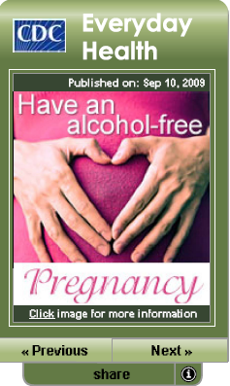
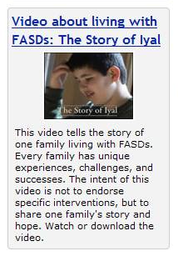
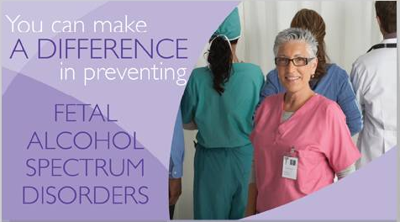
Tools from www.cdc.gov/fasd
Elizabeth P. Dang, MPH, Behavioral Scientist, FAS Prevention Team, National Center on Birth Defects and Developmental Disabilities, Centers for Disease Control and Prevention

Slide 40
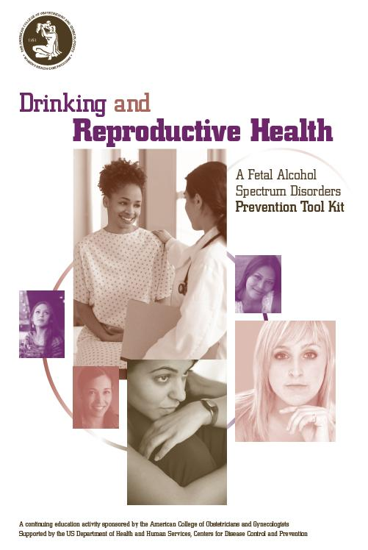
FASD Prevention Tool Kit
Developed by ACOG and CDC
Contains
Brief guide
Laminated screening
instrument
Resource information
Patient handouts
CME credits available

Slide 41
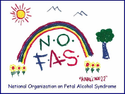
Information and Treatment Resources
National Organization on FAS (NOFAS)
(202) 785-4585 www.nofas.org
Local Alcohol and Drug Treatment Resources
http://findtreatment.samhsa.gov/facilitylocatordoc.htm
CDC FASD Home Page www.cdc.gov/fasd
Southeast Fetal Alcohol Spectrum Disorder Regional Training Center
(FASD RTC) in the Meharry Medical College Department of Family & Community Medicine
615) 327-5525
www.familymedicine.mmc.edu
www.fasdsoutheast.org

Slide 42
FASD Regional Training Centers 2011-2014
Washington
Montana
North Dakota
Minnesota
Vermont
Maine
Oregon
Michigan
New
Hampshire
Idaho
South Dakota
Wisconsin
Massachusetts
Wyoming
New York
Michigan
Rhode Island
Nebraska
Iowa
Pennsylvania
Connecticut
Nevada
New Jersey
Indiana
Ohio
DC
Delaware
Utah
Illinois
Maryland
California
Colorado
West
Virginia
Virginia
Kansas
Missouri
Kentucky
Tennessee
North Carolina
Arizona
New Mexico
Oklahoma
Arkansas
South
Carolina
Mississippi
Georgia
Alabama
Texas
Louisiana
Florida
Alaska
Arctic RTC, Univ of Alaska Anchorage
Midwestern RTC, Saint Louis Univ
Hawaii
Great Lakes RTC, Univ of Wisconsin
Southeastern RTC, Meharry Medical College
Frontier RTC, Univ of Nevada Reno
Notes:
5 CDC-funded regional training centers

