Slide 1

Improving the Lives and Learning of Children and Youth
Insert Name and Date
Location

Slide 2

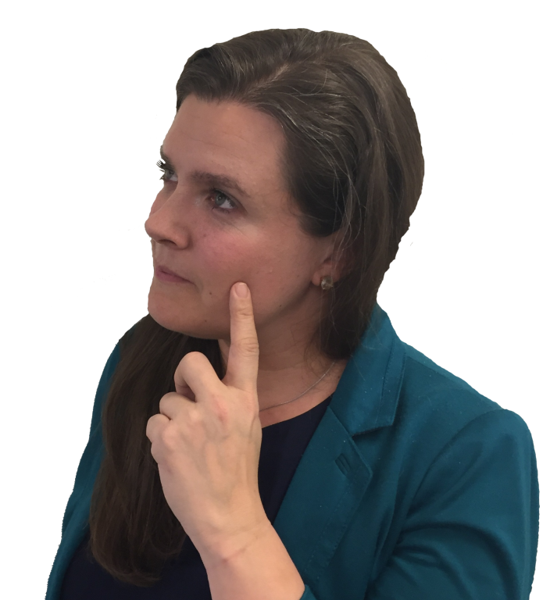
What do you want for your career?
Help create effective schools?
Assist families and teachers?
Make a positive difference in someone’s life?
Contribute to supportive communities?
Work with children and/or youth?
Notes:
Going into graduate school and selecting a career are important, high-stakes decisions. You should continually ask yourself what you are looking for and what excites you about a potential career in psychology or education. We share this because as important as it is to help the right people discover school psychology, we also want people to select the profession that is right for them.

Slide 3

What are you looking for in a job?
Lots of
job openings?
Diverse roles and responsibilities?
Good salary
and benefits?
Job flexibility
and stability?
Notes:
Certainly, these are things that most people would agree are good qualities in a career path, and they are all true for school psychology.

Slide 4
School Psychology might be the career for you!

Slide 5
Who are school psychologists?
Highly-qualified professionals with a graduate degree
Work in schools and related settings
Provide comprehensive psychological and educational services to diverse students
Promote children’s learning, positive behavior, and development
Support students’ social, emotional, and mental health
Notes:
All school psychologists must receive graduate-level training to qualify as a school psychologist
Schools and related settings – related settings may include special education centers (e.g., early childhood centers for children with disabilities), departments of education, clinical settings with an education focus, or even independent practice or hospitals in some states.
Comprehensive services – describe what some of those services might look like

Slide 6
What do School Psychologists do?
Conduct assessments, counseling, and other mental health and academic services
Work with children individually and in groups
Collaborate with parents, teachers, and administrators
Help schools, families, and communities provide successful outcomes for children
Notes:
Again, describe what mental health and academic services might look like (e.g., behavioral assessments and interventions, crisis response, threat assessment, individual and group counseling, etc.)

Slide 7
INSERT A PERSONAL STORY OR SPECIFICS
(Alternative: insert a testimonial or video?)
Notes:
Personal stories and examples are critical to the interest of the presentation. Ideally the presenter will use their own experiences. If not, we can provide at the of the presentation some slides with testimonials and links to video clip testimonials on the NASP website. The presenter can select which of these will work best with the audience

Slide 8
When do children NEED a School Psychologist?
Learning difficulties
Behavior and attention concerns
Problems with peers (isolation, bullying)
Depression and other mental health issues
Coping with crisis & trauma (natural disasters, war, school violence, abuse, rape)
Poverty, violence, homelessness, foster youth, loss, grief
Family issues (divorce, death, substance abuse, military deployment)
Notes:
Feel free to add other needs to the list
Any specific examples from your school(s) or students?
How have you handled Sept. 11th, war in Iraq, etc.?
Note: School psychologists also work in roles promoting social, emotional, mental and behavioral health – not always responding to students in significant need or in crisis.

Slide 9

Most school psychologists work in K-12 public schools.
Notes:
School psychologists have the opportunity to apply the principles of psychology to the learning and development and children and adolescents. It’s been said that school psychologists are the educators with the most knowledge of psychology, and the psychologists with the most knowledge about education. It therefore makes sense that most school psychologists work in school settings, which is where their skillset can be best realized and utilized.

Slide 10



Where do School Psychologists work?
86%
Public Schools
7.7%
10%
Colleges & Universities
8%
Private Schools
7%
Private Practice
6.7%
Faith-Based Schools
1.6%
Dept. of Education
1.5 Clinics & hospitals
Sources: Walcott, Charvat, McNamara, & Hyson (2015)
Notes:
Vast majority work in K-12 public schools. Many school psychologists elect to also engage in some secondary employment on weekends where they qualify.

Slide 11


Who are today’s School Psychologists?
Gender
83%
women
16%
men
Sources: Walcott, Charvat, McNamara, & Hyson (2015)
Notes:
Like other helping professions and the general field of education, it’s predominantly female yet has slowly started to trend towards more men than in previous years. Men are particularly needed in the profession, like many other areas in education.

Slide 12
U.S. Demographics: Ratio of Girls to Boys Receiving Special Education Services
Girls
Boys
:
Notes:
This slide is representing the 1:2 ratio of females to males in special education – showing how the makeup of school psychology does not necessarily mirror the students most in need.

Slide 13
Who are today’s School Psychologists?
Racial/Ethnic Characteristics
Sources: Walcott, Charvat, McNamara, & Hyson (2015)
Notes:
School psychology has historically had limited representation from culturally and linguistically diverse backgrounds. It’s a well need within the field to recruit a more diverse workforce to meet the needs of the increasingly diverse students and families in our schools and communities. The demographics of the field are not representative of the increasingly diverse students enrolled in public schools.

Slide 14
U.S. Demographics
Racial/Ethnic Characteristics
Source: www.cencus.gov
Notes:
As you can see here, compared to the previous slide, the current make-up of school psychologists suggests that there are way more White and way fewer Hispanics compared to the total population, and particularly the population of those Under 18.

Slide 15
Who Are Today’s School Psychologists?
Linguistic Diversity
Sources: Walcott, Charvat, McNamara, & Hyson (2015)
Notes:
CORE SLIDE
If your area has a large immigrant population, discuss the impact of linguistic diversity on your practice. How do you deal with issues of language and culture?
Language differences can create some barriers in engaging with students and/or their families.

Slide 16
U.S. Demographics
Linguistic Diversity – Ages 5 and older
Among those speaking a language other than English
Notes:
As of 2011 → https://www.census.gov/prod/2013pubs/acs-22.pdf
79% of all individuals report speaking English only.
Collecting an accurate number of people who use ASL is difficult, because those data are not collected by the American Census.
Presenter can emphasize that as our students and families become increasingly diverse linguistically, the field will continue to evolve and need individuals from culturally and linguistically diverse backgrounds.

Slide 17

Calling ALL potential school psychologists, but especially…
Males
Individuals from non-white backgrounds
Bilingual individuals
Notes:
This is not to discourage others from applying. In truth, we need anyone that has a passion for working in this capacity.

Slide 18
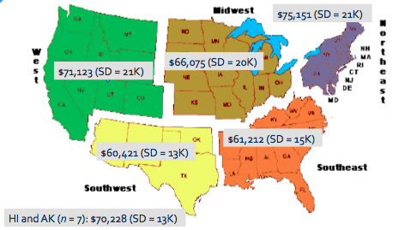
Average Salary by Region

Slide 19
How to Become a School Psychologist
Preparation for graduate school
Graduate school coursework
Practicum experience
Internship

Slide 20
Preparation for Graduate School
A bachelor’s degree with a major in:
  Psychology
  Child Development
  Sociology
  Education or related field
Volunteer or work experience with children and youth
  For example; camp, school, YMCA, or mentoring program
Notes:
Having one of these majors is not an absolute requirement but is ideal.
Don’t NEED all these courses, but they are helpful. One or more of the following courses can help both in the application process, but also identifying whether SP is the right field for you.
Discuss respecialization here. So people in related fields may have an opportunity to enter a program and even have some courses waived. It often is encouraged and enriches courses when other professionals enter a program and share their perspectives (e.g., teachers, school counselors, other mental health professionals).

Slide 21
Considerations When Applying to Programs
Preparation for Graduate School
Degree level
Program Approval
Faculty
Size of program
Location
Research opportunities
Availability of financial support
Employment rates
Rate of completion
Advising opportunities
For more information: http://apps.nasponline.org/standards-and-certification/graduate-education/index.aspx
Notes:
Program approval and accreditation – impacts access to different credentials in various states
Faculty – do their interests align with yours from a research perspective
Location – may impact the kinds of field experiences you will receive
Financial support – discuss that other than scholarships, many programs offer assistantships that require work (research labs, teaching) which come with a stipend and some kind of partial or full tuition waiver.
Employment rates and rate of completion, and other associated outcomes, are all available at the website at the bottom on the NASP website. These data are updated annually

Slide 22
Selecting a Degree Program
Preparation for Graduate School
Specialist-Level (EdS; CAGS, CAS)
>60 graduate semester hours
3+ years full-time (includes one year internship)
Entry-level degree
Typically allows for work in schools
Doctoral-level (PhD, PsyD)
>90 graduate semester hours
5-6+ years (includes one year internship)
Allows for work in schools, academia, research
More options for independent practice
Notes:
Specialist-degree – SOME states allow non-doctoral school psychologists to provide services in independent practice through some other licensing board or under supervision of a doctoral-level professional.
Some universities have both a SP and DOC program, and often allow specialist students to seamlessly transfer to the doctoral program after the first or second year of the program. Something to inquire about or consider if you are not sure.
Some attendees may want to know about differences in degrees. Specialist-level degrees are essentially the same with different degree titles, but no fundamental difference in skills or content of the program. PhD vs PsyD tends to differ in emphasis on research (PhD) vs. practice (PsyD) – yet both maintain focus on application of research to practice.
Should be based on career interests and aspirations. Typically a doctoral degree is a research-based degree. No evidence that doctoral-level professionals are more effective practitioners than specialist-level.
Both result in ability to work as a school psychologist and earn NCSP credential. No state requires doctoral degree to work in schools as a school psychologist.

Slide 23
Program Approval/
Accreditation
Preparation for Graduate School
Most graduate programs hold one or more types of accreditation:
  NASP-approval of specialist and doctoral levels
    http://www.nasponline.org/standards-and-certification/graduate-program-approval/nasp-approved-programs
  APA accreditation for doctoral programs
  State department of education approval for programs that lead to a state certificate or license for graduates
Notes:
Go over the implications of each type of approval or accreditation
Any kind of accreditation suggests that there has been some extensive third-party review to ensure that national standards are met, and that the program meets both content (curriculum and experiences) and infrastructure (enough faculty, program resources, access to materials, etc.) standards.
NASP-approval is now required in a few states to work as a school psychologist. Streamlines NCSP application.
APA-Accreditation only for doctoral programs – can help in accessing board of psychology licensure for independent practice
PROGRAMS CAN HAVE BOTH APA-ACCREDITATION and NASP-APPROVAL AT THE SAME TIME

Slide 24
Graduate school coursework
Develops knowledge and skills in
Prevention and Intervention Services for Students and Families:
Assessment
Academic/learning interventions
Mental and behavioral health interventions
Instructional support
Special education services
Crisis preparedness, response, and recovery
Family-school-community collaboration
Cultural competence
Notes:
FOR THIS SLIDE AND THE NEXT:
Share a couple of brief examples of courses you took in graduate school and how they helped you develop this knowledge and these skills
Share what graduate school classes in school psychology look like, what it takes to be successful in them, and how they may be similar to or different from undergraduate classes (e.g., smaller; more discussion, application; need to come to class prepared, be willing and able to ask and answer questions, respond to written and oral feedback; likely more engaging, since they are all in your chosen field of study)

Slide 25
Graduate school coursework
Develops knowledge and skills in
Foundations of Services Needed in Schools
Data collection and analysis
Resilience and risk factors
Consultation and collaboration
Diversity in development and learning
Research and program evaluation
Professional ethics
Education law

Slide 26
Graduate School Field Experiences
  Supervised experiences in schools, clinics, or related settings throughout your graduate program allow you to apply specific skills and techniques learned in courses.
  Culminating experience
  Provides intensive and supervised preparation for first job
  Full year (1200-1500+ hours)
Practicum Experiences
Internship
Notes:
Describe how practicum is often in concert with coursework.
Discuss internship stipends, options on internship (i.e., different settings, types of supervisors), can often be out of state from the home program.

Slide 27
Getting a Job
School psychologists must hold a current, valid state credential for practice
A state-by-state summary of school psychologist certificate and license requirements is found at:
  https://www.nasponline.org/standards-and-certification/state-school-psychology-credentialing-requirements
Independent practice may require an
additional credential
Notes:
Credentialing requirements differ from state to state – though in EVERY state, the specialist-level degree is the entry level degree, which is consistent with the national standard/recommendation from NASP.
Many states require doctoral degree for independent practice, yet not all of them.

Slide 28

Job Outlook?
High national demand for school
psychologists
Federal education law includes provisions for school psychologists services
Particular need for professionals from culturally and linguistically diverse backgrounds
For several years, “school psychologist” has been listed in Top 10 among Best Social Services Jobs in U.S. News &World Report.
Stable career with good benefits
Notes:
Most programs report at or near 100% job placement rate.

Slide 29
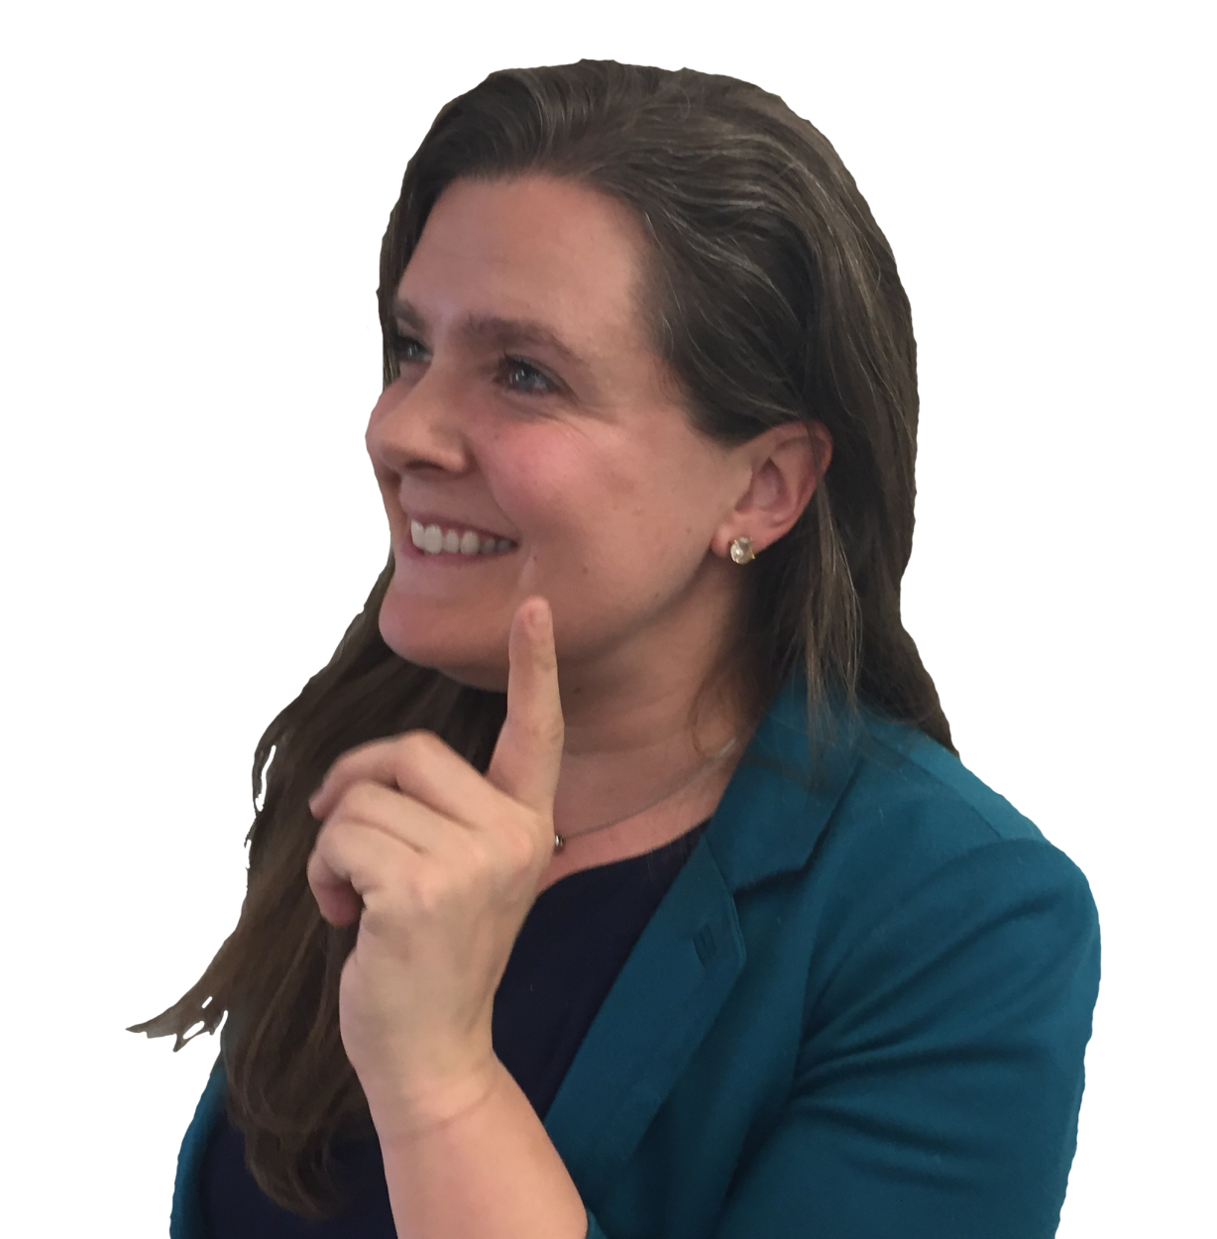
A Great Career Choice!
Positively impact the lives of youth
Help parents and educators
Flexible school schedule
Range of responsibilities
Variety of work settings

Slide 30

Questions?

Slide 31
References/Resources
Castillo, J.M., Curtis, M. J., Chappel, A., & Cunningham, J. (2011, February). School psychology 2010: Results of the national membership study. Paper presented at the annual convention of the National Association of School Psychologists, San Francisco, CA.
Fagan, T. K., & Wise, P. S. (2007). School psychology: Past, present, and future 3rd Ed. Bethesda: NASP.
Harrison, P., & Thomas, A. (2014). Best practices in school psychology VI. Bethesda: NASP.
U.S. Census Bureau (2010). Place of Birth of the Foreign-Born Population: 2009. Washington, DC: U.S. Census Bureau. www.census.gov/prod/2010pubs/acsbr09-15.pdf
U.S. Census Bureau (2010). Race and Hispanic Origin of the Foreign-Born Population in the United States: 2007. Washington, DC: U.S. Census Bureau. www.census.gov/prod/2010pubs/acs-11.pdf
U.S. News & World Report. Best Social Service Jobs. Retrieved from http://money.usnews.com/careers/best-jobs/school-psychologist
Notes:
Add NASP resources and URLs

Slide 32
For more information, contact:
National Association of School Psychologists www.nasponline.org

Slide 33
As an African American school psychologist, I knew I could make a difference with individuals, groups, and systems that allow trends of disproportionality to continue. But even more importantly, I knew that by becoming a culturally responsive school psych, I could spread best practices in general and special education that could improve the learning experiences for all students.
— Nicholas McIntosh, EdS
School Psychologist, California
Notes:
Testimonials provided for the presenter’s use as desired. Presenter may integrate these quotes in presentation or delete.

Slide 34
“Ya’at’eeh. Greetings! I am Diné/Navajo. I aspire to advocate for our Native American students who continue to be disproportionately underrepresented and misidentified in Special Education and increase the awareness and insight in the areas of historical and intergenerational trauma –a powerful dynamic that continues to impact Native students’ identities and academic success today.”
— Alyssa Ashley, EdS , School Psychologist, Arizona
Notes:
Testimonials provided for the presenter’s use as desired. Presenter may integrate these quotes in presentation or delete.

Slide 35
“As an African- American male, I am driven to become a change-agent at schools for students from culturally linguistically diverse (CLD) backgrounds. As a future school psychologist, my dream is to empower students to understand that they can succeed no matter what obstacles; they may face during their educational career.”
— Daunte Haynes, M.A.
EdS School Psychology Student, California
Notes:
Testimonials provided for the presenter’s use as desired. Presenter may integrate these quotes in presentation or delete.

Slide 36
I love the variety in my job. I do assessment, counseling, consultation, direct academic and behavioral intervention, staff support and training , and crisis response. No day is ever the same!
-- Jaimi McDonough, Ph.D., School Psychologist, Texas
Notes:
Testimonials provided for the presenter’s use as desired. Presenter may integrate these quotes in presentation or delete.

Slide 37
I became a school psychologist because I have a passion for working with and helping kids accomplish their goals. I also love working in a school setting and collaborating with teams of coworkers to solve problems.
--Lynsi Havens
EdS School Psychology Student, Wisconsin
Notes:
Testimonials provided for the presenter’s use as desired. Presenter may integrate these quotes in presentation or delete.

Slide 38
Being a school psychologist is the best job I’ve ever had. I get to improve children’s lives and support appropriate educaiton for all. It’s a great feeling to know you’re making a positive impact on the future.
--Susan Jarmuz-Smith, School Psychologist, Maine
Notes:
Testimonials provided for the presenter’s use as desired. Presenter may integrate these quotes in presentation or delete.

